Slide 1

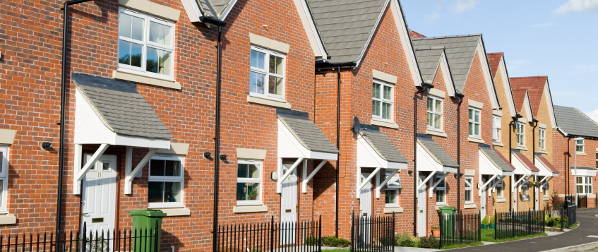
Local Plan (2036) Growth Viability Study
Consultation on Preparation of Evidence Base
Prepared on behalf of Huntingdonshire District Council
24 April 2017

Slide 2
Agenda
Welcome and Introduction | 10.00 –10.10
Approach to Viability Testing | 10.10 – 10.30
Viability Assumptions | 10.30 – 11.00
Discussion | 11.00 – 11.50
Summary and Close | 11.50

Slide 3
Approach to viability testing

Slide 4
Purpose and scope of instructions
To provide viability evidence to support the emerging Local Plan, Huntingdonshire Local Plan 2036, including:
a. Policy development viability testing
Affordable housing requirement viability testing
Viability testing for a range of site types
The primary objectives of the Growth Viability Assessment are to:
a. support the deliverability of the HLP2036, by ensuring that the Local Plan vision, allocations and policies are viable and deliverable; and
b. enable the Council to maximise gain through planning obligations in order to improve delivery of infrastructure and affordable housing, whilst balanced against the desire to encourage growth and delivery across the district.

Slide 5
Viability context
NPPG:
Need to show an ‘appropriate balance’
Area-based approach
No particular valuation method advised
‘appropriate available evidence’
Sample an appropriate range of sites across its area
Viability buffer
All development costs including abnormals

Slide 6
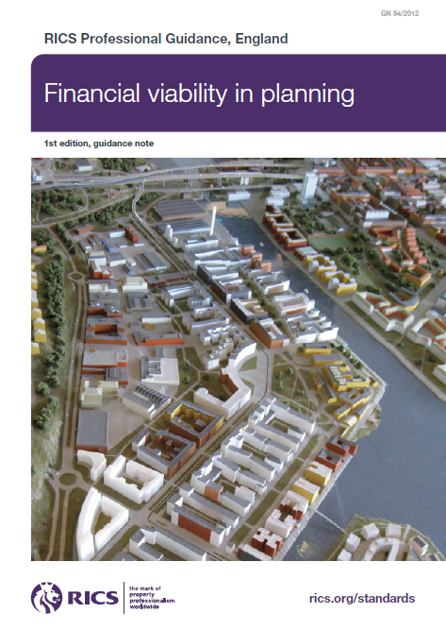
What is a viability test?
Paragraph 2.1:
‘An objective financial viability test of the ability of a development project to meet its costs including the costs of planning obligations, while ensuring an appropriate site value for the land owner and market risk adjusted return to the developer in delivering the project.’
Paragraph 173 of the NPPF states
‘…Provide competitive returns to a willing land owner and willing developer to enable the development to be deliverable…’
A requirement of paragraph 015 of the NPPG for:
‘A competitive return for the land owner is the price at which a reasonable land owner would be willing to sell their land for the development’

Slide 7
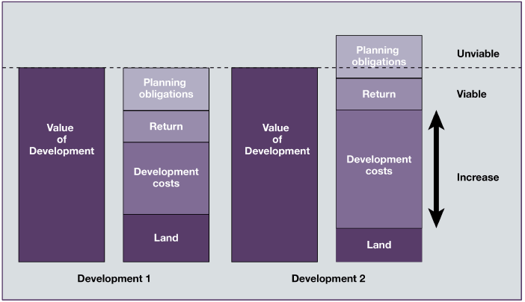
Principles of economic viability testing

Slide 8
C&W Approach for Typology Viability Testing
Input to Calculate RLV
Is the RLV sufficient?
Compare RLV with the return for a “willing landowner” (Benchmark Site Value (BLV))
Research Inputs & Factors
Calculate Residual Land Value (RLV)
Value areas
The Gross Development Value
Scheme Typologies
Residual Land Value
less
Benchmark Land Value
Less all development costs including profit and planning requirements (including CIL)
Draft Local Plan Policy
If £ + /ve - - Viable
If £- / ve - Not Viable (Sense Test e.g. lower affordable housing)
Appraisal assumptions / sensitivities
Equals the
residual land value (RLV)

Slide 9
Approach to Residential Typologies
Drawing on individual site assessments undertaken through an Environmental Capacity and Land Availability Assessment, HLP 2036 includes a package of sites proposed as capable of delivering the development strategy for the district up to 2036.
For each site, HLP 2036 has assumed certain development densities, and the proposed modelling has sought to reflect this by way of the typologies tested
On this basis, a number of different typologies will be tested to reflect the different circumstances of sites across Huntingdonshire District, as proposed in the Local Plan, including

Slide 10
Viability Testing Assumptions

Slide 11
Approach to Residential Typologies
Market Area (expressed through different assumptions regarding sales values and benchmark land values)
Development Size
  A range from 11 dwellings, through to 1,500 dwellings
Development Context
  Greenfield
  Previously Developed Land
Development Density:
  60 dwellings per hectare (dph) - (Tested at 50 dwellings, Previously Developed Land only)
  50 dwellings per hectare (dph) - (Tested at 25 dwellings (Ramsey); 50 dwellings (Ramsey, Huntingdon, and St Ives); and 100 dwellings (Huntingdon) – all assuming Previously Developed Land only)
  40 dwellings per hectare (dph) - (Tested at 1,500 dwellings, Greenfield and £240/sqft value band only)
  35 dwellings per hectare (dph) – (Tested at 11 – 1,500 dwellings, Greenfield and Previously Developed Land)

Slide 12
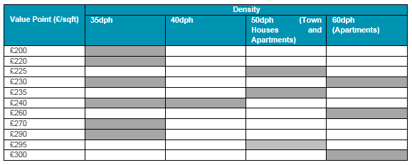
Approach to Residential Typologies
Value Points
  Broadly reflecting the location of the allocations that the typologies tested seek to reflect, the following value points are proposed to be tested, by density typology.

Slide 13
Approach to Residential Typologies
Dwelling Sizes
  These are sensitive to the development density tested, as follows:
Density Tested | Average Dwelling Size
35dph | 1,050 sqft (market) | For market dwellings, an average size of 1,050 sqft was assumed, and which is within the average range suggested by analysis of the SHMA recommendations (Relates to Policy LP20 regarding housing mix) regarding houses (1,041sqft to 1,111sqft). For the affordable dwellings, an average size of 750sqft was agreed with the HDC Policy and Enabling Officer.
40dph | 950 sqft (market) | Assumes a smaller average size of dwelling than 35dph on account of the higher density (Presuming all houses). For the affordable dwellings, an average size of 750sqft was agreed with the HDC Policy and Enabling Officer.
50dph | 885 sqft | Assumes a blend of apartments (25%) and townhouses (75%). Assumes all apartments average 600sqft net. This assumes a net to gross ratio of 85%, for the purposes of calculating Gross Internal Area. Assumes the town houses average 975sqft. The blended (Net Internal Area) average of the apartments and townhouses is 885sqft
60dph | 600 sqft | Assumes all apartments (600sqft net, assuming a net to gross ratio of 85%, for the purposes of calculating Gross Internal Area)

Slide 14
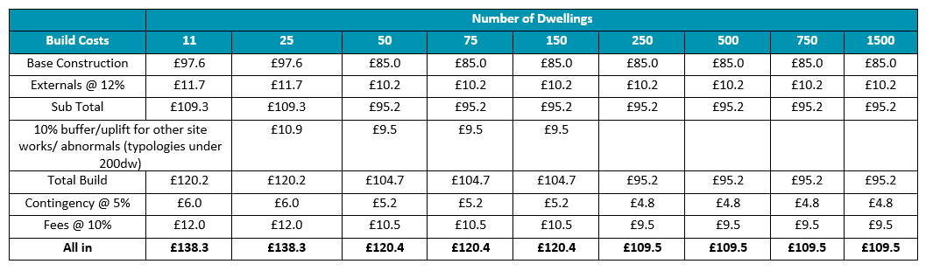
Build Costs (Houses)
Build costs for houses are based on BCIS (November 2016) rebased for Cambridgeshire)
Garages included in base construction
Focus on “All In” build cost (To reflect different approaches taken to presenting fees, contingency etc)
Cost profile reflects size of site, wider volume housebuilder interest for larger sites
“Buffer” for strategic sites (250dw plus) included in £20,000/dwelling infrastructure allowance

Slide 15
Build Costs (Apartments)
Build costs for houses are based on BCIS (November 2016) rebased for Cambridgeshire)
Base Construction Cost of £125.95/sqft
BCIS Median for Cambridgeshire as of November 2017 (£114.5/sqft)
Plus 10% for external works (£125.95/sqft)
Fee allowance: 10%
Contingency: 5%

Slide 16
Profit and Development Overheads
Other development costs
Marketing, sales agent and legal fees | 3.5% of sales revenue
Purchaser's costs | SDLT and 1.75% agent and legals
Finance | 6.5% on negative balance
Developer's profit | Blended rate (20% of GDV on market units & 6% of GDV on affordable units)

Slide 17
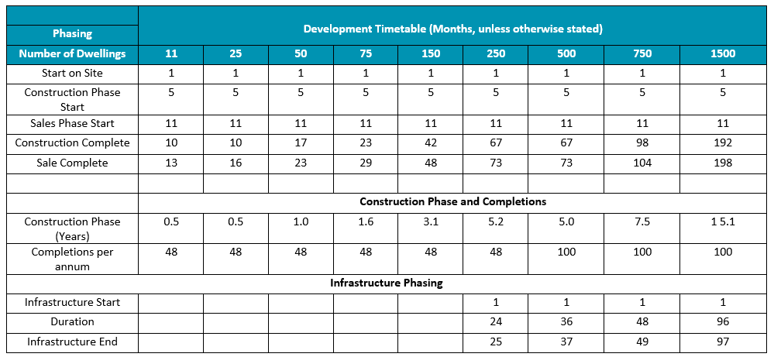
Development Phasing (35dph and 40dph)
4 month construction lead in; 6 month sales lead in after construction
Infrastructure (£20,000 / dw for 250dw plus): Complete by between half way and two-thirds through scheme (Relatively earlier for 250 dwelling typology)
Sales Completions around 48 dw/annum (under 250 dw); 100-150 dw/annum for 1,500 dw SUE

Slide 18
Development Phasing (Other densities)
60dph Typology (50 dwellings)
apartments based typology,
sales (12 months) begin on completion of the construction phase (12 months).
50dph Typology (25, 50 and 100 dwellings)
This typology is a blend of apartments and houses, and the development phasing reflects this.
  100 dwellings:
    25* apartments; 75 houses
    2 year build period,
      with sales of apartments beginning after 12 months with the completion of the first apartment block (and on practical completion for the affordable apartments)
      With sales of houses beginning six months into the construction period over a period of 19 months
  50 dwellings:
    12*apartments; 38 houses
    1 year build period
      with sales of apartments beginning after 12 months with the completion of the apartment block (and on practical completion for the affordable apartments)
      With sales of houses beginning with the construction completion of the apartment element. (the small size of the scheme meaning it would be impractical for sales completions on the houses whilst the apartment block is still under construction)
  25 dwellings
    6*apartments; 19 houses
    1 year build period
      Sales of apartment beginning after 12 months with the completion of the apartment block over a period of six months (and on practical completion for the affordable apartments)
      With sales of houses beginning with the construction completion of the apartment element. (the small size of the scheme meaning it would be impractical for sales completions on the houses whilst the apartment block is still under construction)

Slide 19
Affordable Housing Policy Testing
Affordable housing | % of all units | Transfer Values a % of Open Market Value
To include a mix of: 70% Affordable Rented 30% Shared Ownership | To test up to 40% (@ 5% iterations- 10%,15%,20%,25%,30%,35%,40%) | Blended rate of 54.5% (Affordable Rent @ 50% OMV; Shared Ownership @65% OMV) (Based on consultation with Huntingdonshire District Council Policy and Enabling Officer (after his consultation with a number of providers)

Slide 20
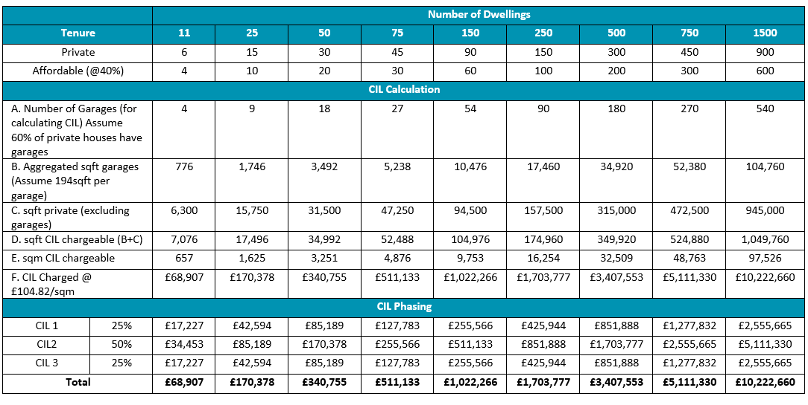
CIL Assumptions – Payment Calculation
e.g. 35 dph typologies @ 40% affordable

Slide 21
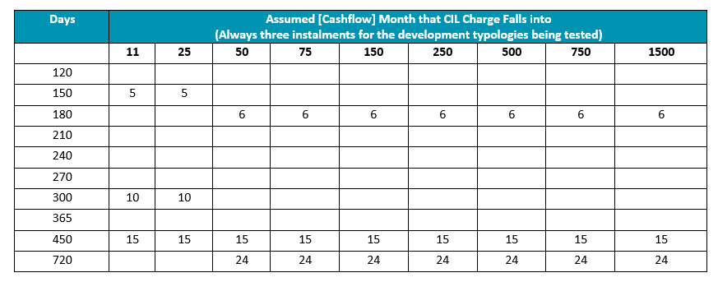
CIL Assumptions – Payment Timing
e.g. 35 dph typologies @ 40% affordable

Slide 22
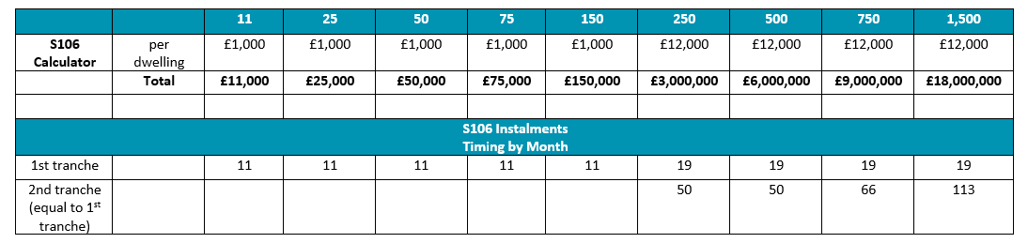
Section 106 – Assumptions
  Payment Calculation
    under 200 dwellings, £1,000 / dwelling
    200 dwellings and over (Due to approach of HDC Developer Contribution SPD) £12,000 / dwelling
  Payment Timing Assumptions by Scheme Size
  Cautious high level view taken; actual timing requirements may be site specific

Slide 23
Other Policy standards with Direct Cost Implications
Policy | C&W Commentary
LP 7 Green Infrastructure | Typologies <200 dw: CIL Contribution Strategic Sites: Through S106 and infrastructure allowances
LP 8 Sustainable Development Principles | Build specification requirements included in build costs
LP16 Surface Water | Cost Implications for SUDs included in abnormals/infrastructure allowance of build cost
LP18 Quality of Design | Build specification requirements included in build costs
LP21 Sustainable Use of Energy and Water | All new homes to comply with the optional building regulations requirement for water efficiency (110 litres per day), as set out in Approved Document G. Not a significant cost, accommodated within build cost allowance

Slide 24
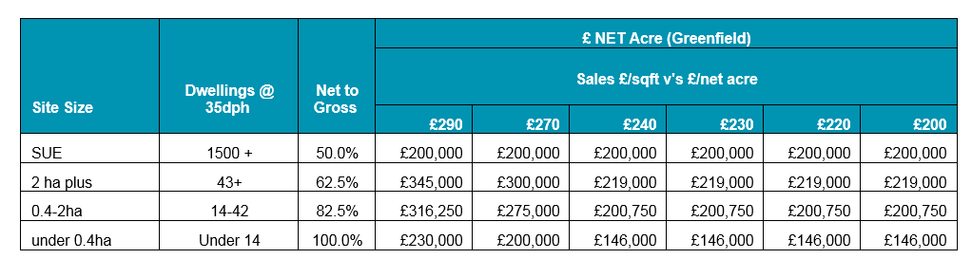
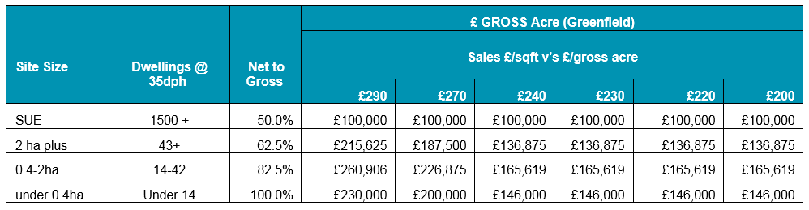
Proposed land value benchmarks
Indicative Greenfield Benchmarks

Slide 25
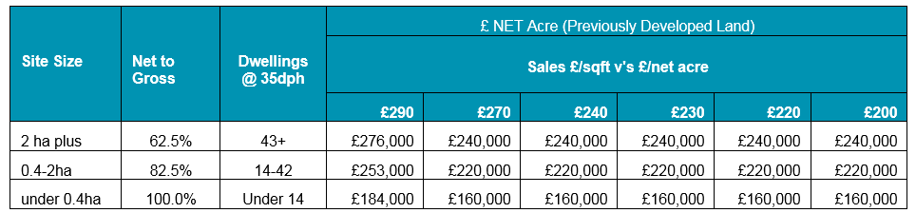
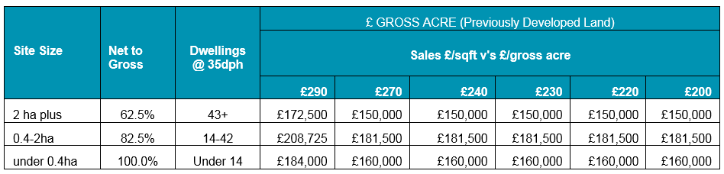
Proposed land value benchmarks
Indicative Previously Developed Land Benchmarks

Slide 26
C&W Approach for Typology Viability Testing
Input to Calculate RLV
Is the RLV sufficient?
Compare RLV with the return for a “willing landowner” (Benchmark Site Value (BLV))
Research Inputs & Factors
Calculate Residual Land Value (RLV)
Value areas
The Gross Development Value
Scheme Typologies
Residual Land Value
less
Benchmark Land Value
Less all development costs including profit and planning requirements (including CIL)
Draft Local Plan Policy
If £ + /ve - - Viable
If £- / ve - Not Viable (Sense Test e.g. lower affordable housing)
Appraisal assumptions / sensitivities
Equals the
residual land value (RLV)

Slide 27
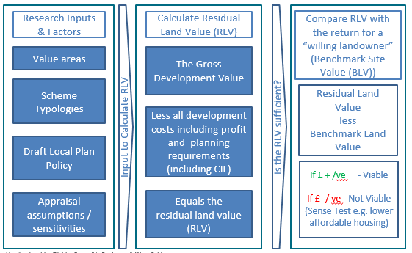
Cushman & Wakefield approach
Typology Viability Testing
Iterative Testing of Viability for each Typology
Varying Affordable Housing (40%,35%,30%,25%,20%,15%, 10% or less)
Implications of testing and results for Policy

Slide 28
Implications of testing and results for policy
Study Aim:
To provide viability evidence to support the emerging Local Plan, Huntingdonshire Local Plan 2036, including:
a. Policy development viability testing
Affordable housing requirement viability testing
Viability testing for a range of site types
The primary objectives of the Growth Viability Assessment are to:
support the deliverability of the HLP2036, by ensuring that the Local Plan vision, allocations and policies are viable and deliverable
      Constants (CIL Rates, Policies of Huntingdon Local Plan to 2036: Targeted Consultation, S106 Assumptions, Infrastructure).
      Variables (Affordable Housing %)
enable the Council to maximise gain through planning obligations in order to improve delivery of infrastructure and affordable housing, whilst balanced against the desire to encourage growth and delivery across the district.
      Getting the Balance right
        % Affordable Housing Target(s)
        Headroom for additional standards / objectives? e.g.
          Accessibility
          Self Build

Slide 29
Discussion

Slide 30
Summary & Close

Slide 31
Timetable
Stakeholder Consultation Responses received by 5pm, Friday April 28, 2017
May 2017: Completion of initial stage of Local Plan Growth Viability Study, to support Local Plan proposed submission consultation
December 2017: Submission of Local Plan to Secretary of State for Examination
2018: Local Plan Examination in Public

Slide 32
Jonathan Tutt
Senior Consultant
0121 697 7306
jonathan.tutt@cushwake.com

